Slide 1

NEXTHIKE IT SOLUTIONS Project-4
User Analytics in the Telecommunication Industry - Overview
By Heena

Slide 2
Index
User Overview Analysis
User Engagement Analysis
Experience Analytics
Satisfaction Analysis

Slide 3
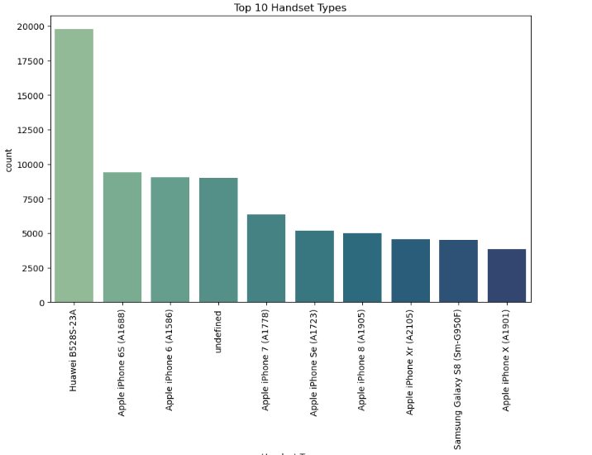
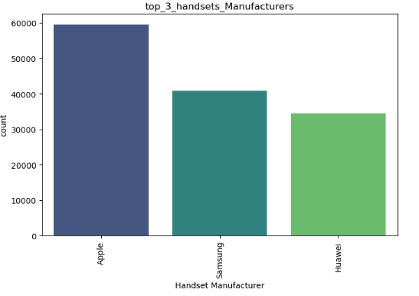
User Overview Analysis
User Overview Analysis is a process of understanding and analyzing user data to gain insights into their behavior, preferences, and needs. It involves collecting and examining data about users, such as:
1. Demographics (age, location, occupation)
2. Behavioral patterns (usage habits, interactions)
3. Preferences (likes, dislikes, interests)
4. Pain points (challenges, difficulties)

Slide 4
User Overview Analysis
Data Collection: Gathering various types of user data, including demographics, usage patterns, feedback, and behavioral data .
Data Analysis: Applying techniques to analyze the collected data, identifying trends, patterns, and areas of interest. This can involve statistical analysis, data visualization, and qualitative analysis of user feedback.
Interpretation: Understanding the meaning behind the data, drawing conclusions about user behavior, needs, and preferences.

Slide 5
Why is user overview analysis important?
Improved User Experience: Understanding user needs and pain points allows for the creation of more intuitive and satisfying products and services.
Targeted Marketing: User analysis helps identify the most relevant customer segments and tailor marketing campaigns for better results.
Increased Customer Satisfaction and Loyalty: By understanding and addressing user needs, businesses can foster greater customer satisfaction and loyalty.

Slide 6
User Engagement Analysis
User Engagement Analysis is the process of measuring and understanding how users interact with a product, service, or platform. It involves analyzing user behavior, such as:
1. Time spent on the platform
2. Frequency of visits
3. Actions taken (e.g., clicks, purchases, shares)
4. Feedback and ratings

Slide 7
Sessions frequency - Session Frequency refers to the number of times a user interacts with a product, service, or platform within a specific period. Duration of the Session - Duration refers to the length of time a user spends interacting with a product, service, or platform during a single session. Types of Session Duration: 1. Average Session Duration: The average time spent by users in a single session. 2. Median Session Duration: The middle value of session durations. Importance of Session Duration: 1. User engagement: Measures user interest and involvement. 2. Content effectiveness: Indicates how well content holds users' attention. 3. User experience: Helps identify areas for improvement.

Slide 8
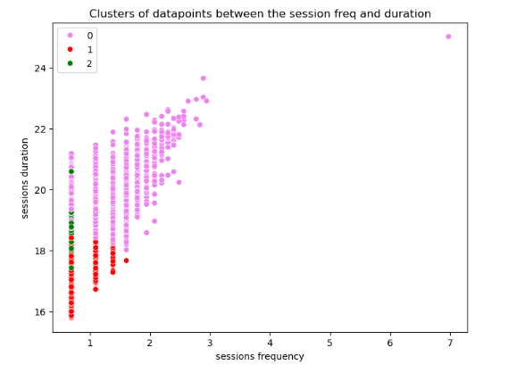
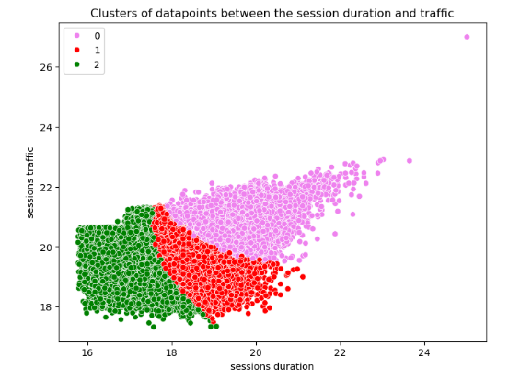
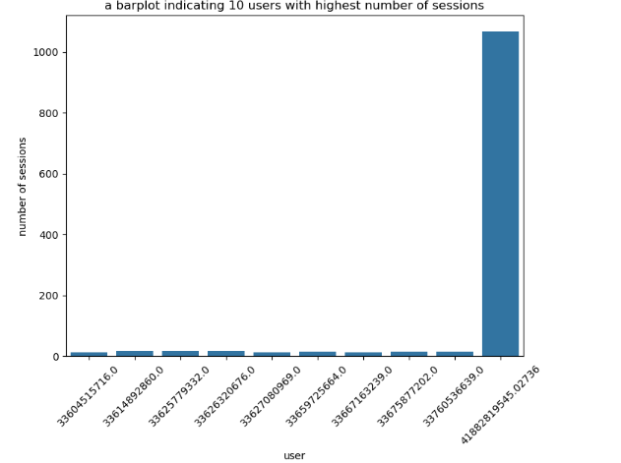
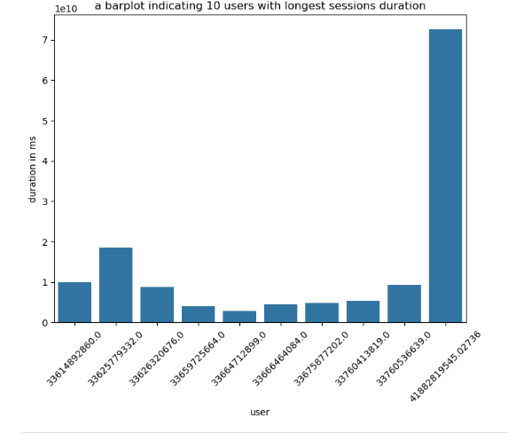

Slide 9
The session total traffic (download and upload (bytes))
Session Total Traffic refers to the total amount of data transferred during a
user's session, including:
Download: Data received by the user (e.g., website content, files).
Upload: Data sent by the user (e.g., form submissions, file uploads).
Measuring Session Total Traffic:
Bytes transferred: Total amount of data exchanged.
Data usage patterns: Analyzing upload and download patterns.

Slide 10
Experience Analytics
Experience Analytics is the process of collecting, analyzing, and interpreting data to understand user experiences across various touchpoints, products, or services. It aims to:
1. Improve user satisfaction: Enhance overall user experience.
2. Increase engagement: Boost user interaction and loyalty.
3. Drive business growth: Inform data-driven decisions to improve products and services.

Slide 11
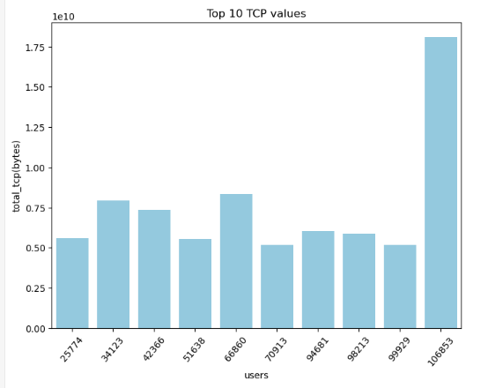
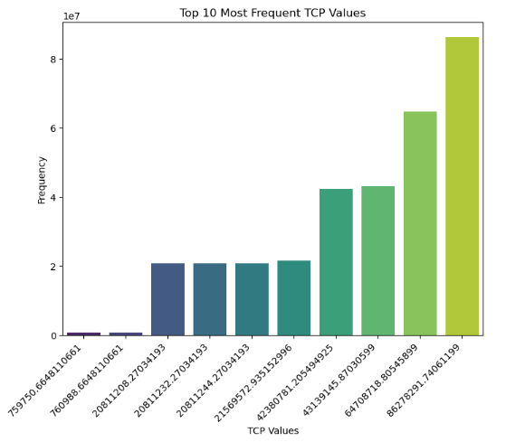
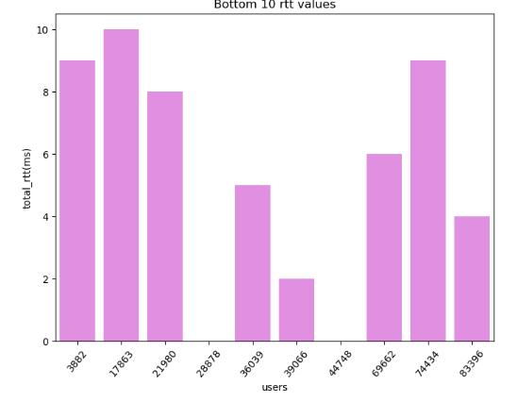
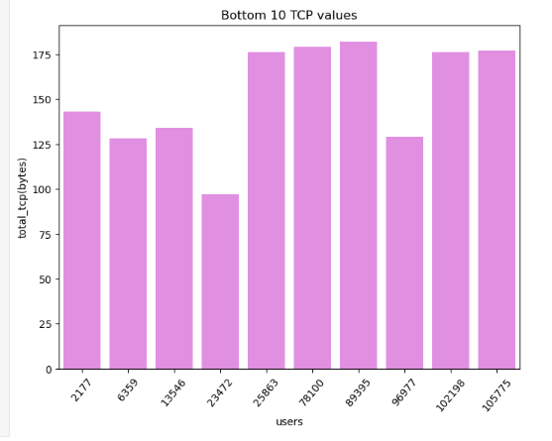

Slide 12
Aggregate, per customer, the following information
Average TCP retransmission - Measures the average number of retransmitted packets due to network errors or congestion. Lower values indicate better network reliability.
Average RTT (Round-Trip Time) - Measures the average time it takes for a packet to travel from the sender to the receiver and back. Lower RTT values indicate faster network responsiveness.
Handset Type - Refers to the type of device (e.g., smartphone, tablet) used to access the network. Different handsets may have varying capabilities and performance.
Average Throughput - Measures the average rate of data transfer over the network. Higher throughput values indicate faster data transfer rates.

Slide 13
Compute & list 10 of the top, bottom, and most frequent:
TCP Values :- Identify TCP-related columns (e.g., TCP retransmissions, TCP connections).- Calculate summary statistics (mean, median, min, max, std dev).
RTT Values :- Identify RTT-related columns (e.g., average RTT, minimum RTT, maximum RTT).- Calculate summary statistics (mean, median, min, max, std dev).
Throughput Values :- Identify throughput-related columns (e.g., average throughput, total throughput).- Calculate summary statistics (mean, median, min, max, std dev).

Slide 14
Compute & report:
Distribution of Average Throughput per Handset Type - To analyze the distribution of average throughput per handset type, we can calculate summary statistics and visualize the data.
Average TCP Retransmission per Handset Type - To analyze the average TCP retransmission per handset type, we can calculate summary statistics and visualize the data.

Slide 15
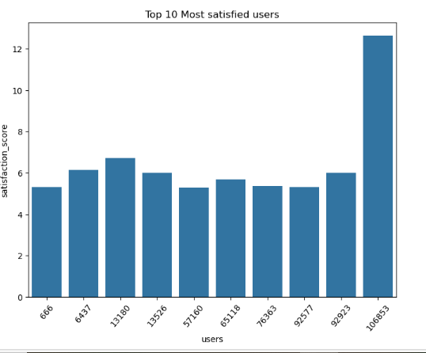
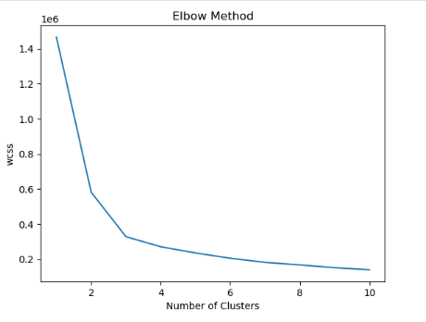
Satisfaction Analysis
Satisfaction analysis is the process of measuring and understanding user satisfaction with a product, service, or experience. It involves collecting and analyzing data to identify areas of strength and weakness.

Slide 16
Websites used for research
https://www.youtube.com/
Meta AI
https://www.geeksforgeeks.org
https://www.google.co.in/
https://github.com/

Slide 17
THANKYOU

